Slide 1

Master in
Computational
Science
Double Degree
FAU$$⟺$$USI

Slide 2
Introduction
Overview
A top-tired education with a double degree at FAU $$⟺$$ USI, Master in Computational Engineering and Computational Science.
Master in Computational Science (MCS)
Double Degree Program
USI Lugano

Slide 3
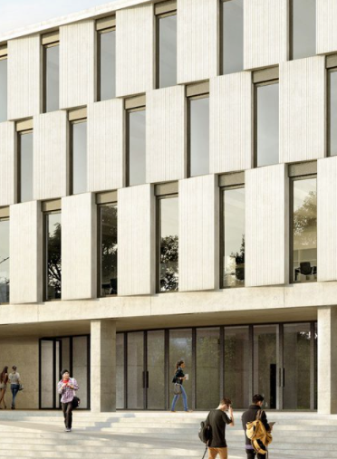
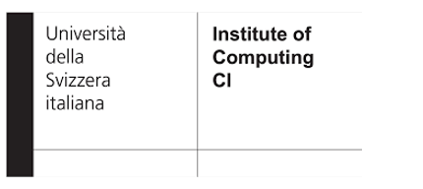
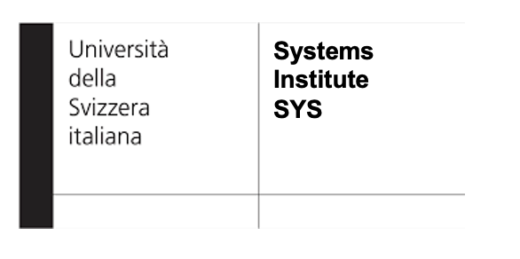


Master in Computational Science
Overview
Master in Computational Science (MCS):
  Supported by the Institute of Computing.
  CSCS/ETH cutting-edge hardware resources.
  Multiple double degree programs.
  Course topics include: HPC, High-Dimensional Data Analysis, Optimization and etc.

Slide 4
Master in Computational Science
Education
Master in Computational Science at USI — Interdisciplinary and Specialized
AI & Data Analytics
Data Science
Computer Science
Numerical Simulation
Application Fields
HPC
1st Semester Core
2nd Semester Elective
3rd Semester Specialization
4^{rth} Semester Thesis Project
Introduction to CS, data science, PDEs, alongside fundamentals in ODEs, ML, and HPC.
Advanced discretization, stochastic methods, optimization, as well as applied courses on simulations and supercomputing.
Elective courses such as bioinformatics, quantum computing, particle methods, and thesis preparation.
Master's thesis project with a dedicated professor.

Slide 5
Structure and organization (an example)
Master in Computational Science
Structure
MSc Thesis
(24 ECTS)
Quantum computing
(6 ECTS)
Spring
4th Semester
Preparation MSc Thesis
Numerical algorithms
(6 ECTS)
Analysis of Social Networks
(6 ECTS)
Advanced topics in Machine Learning(6 ECTS)
Bioinformatics
(6 ECTS)
Fall
3rd Semester
Discretization methods
(6 ECTS)
Stochastic Methods
(6 ECTS)
Solution methods and Optimization
(6 ECTS)
Particle Filtering
+
Bayesian Computing
(3 + 3 ECTS)
Effective High-Performance Computing & Data Analytics
(6 ECTS)
Spring
2nd Semester
Efficient Computational Algorithms
(6 ECTS)
Ordinary Differential Equation
(3 ECTS)
Introduction to Comp. Science
(3 ECTS)
Introduction to
Machine Learning
(6 ECTS)
Introduction to Data Science
(6 ECTS)
High-Performance Computing
(6 ECTS)
Fall
1st Semester
DATA SCIENCE
MATH/ALGORITHMS
COMPUTING
APPLICATION

Slide 6
Double Degree
Overview
Master in Computational Engineering $$⟺$$ Master in Computational Science
Academic Requirements:
30/120 ECTS must be taken at USI.
Mobility after the first semester.
Online and in class course.
Grading policy equivalence.
Costs and Mobility Grants:
Student do NOT pay USI fees.
10 ERASMUS/SEMP mobility grants FAU → USI for 6 months (deadline January 10th).
Lugano prices (beer 6 CHF, shared-flat 500 CHF).
For more information see: ci.inf.usi.ch/master/double-degree-faq

Slide 7

Double Degree
Registration
Registration¹ at bit.ly/usi-fau-register
Deadline September 30th
1) Also available at https://usi.qualtrics.com/jfe/form/SV_5o47NZex2AdG0Oa

Slide 8
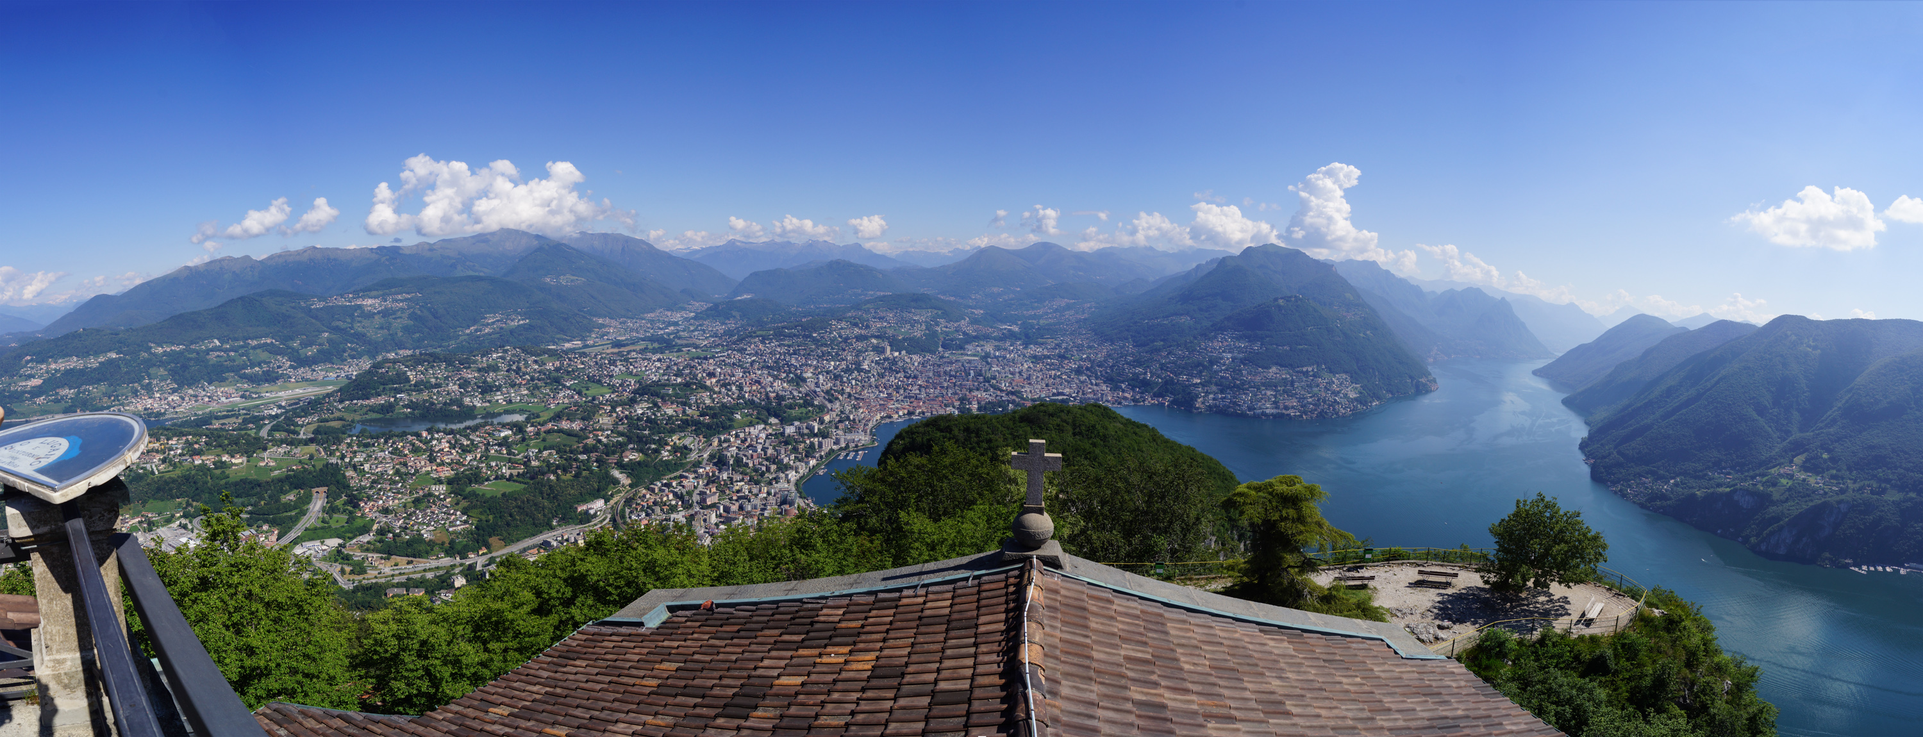
USI Lugano
Zurich (2h)$$⟶$$ Lugano (1hr)$$⟶$$ Milan
… any given day from March to October.

Slide 9
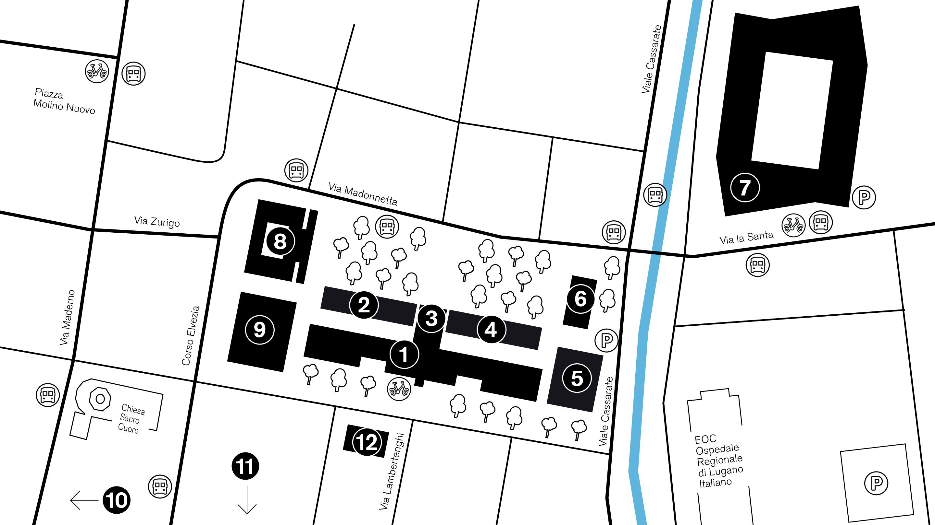
USI Lugano
Campus
Main Building
Black Building
Auditorium / Mensa
Red Building
Theology
Lab / EOC
East Campus Lugano
Library
Aula magna
L'ideatorio (Villa Saroli)
Il Litorale (Piazza San Rocco)
Blue Building

Slide 10
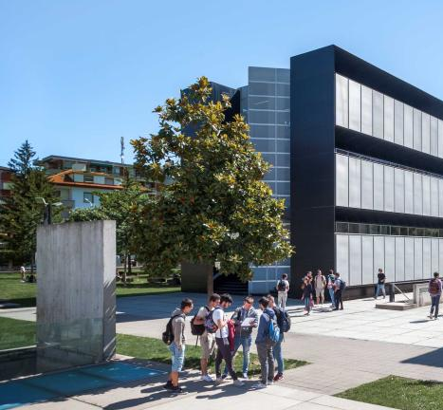
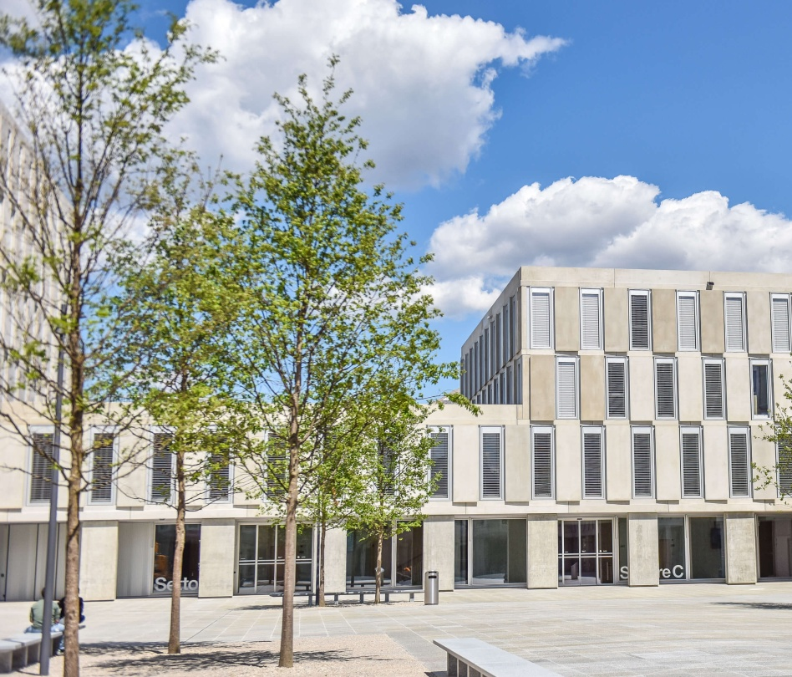
USI Lugano
West/East Campus

Slide 11
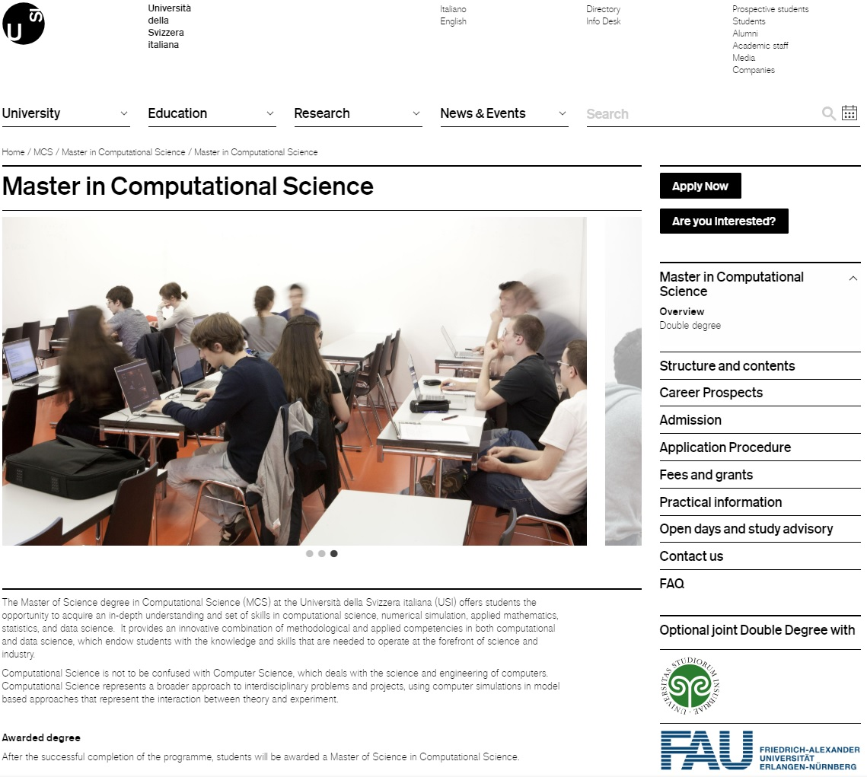
Questions
Study Coordinator:
aryan.eftekhari@usi.ch
Academic Directors:
olaf.schenk@usi.ch
ernst.jan.camiel.wit@usi.ch
See website for details.

